Slide 1
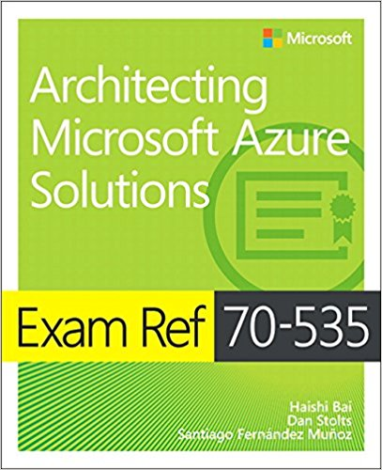
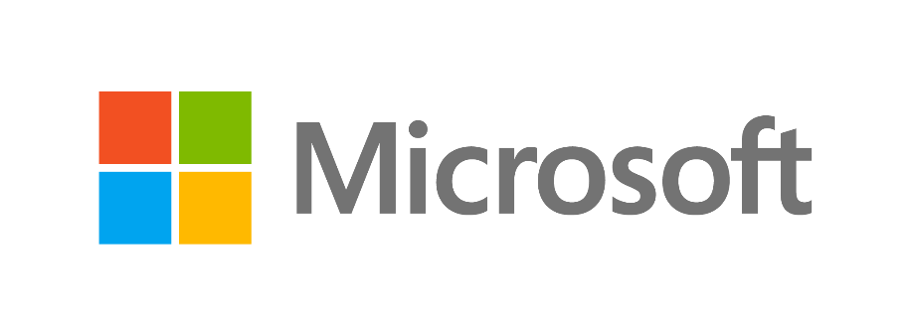
Exam 70-535 Architecting Microsoft Azure Solutions Data & Cloud Skill Up Workshop - Azure Fundamentals
Welcome
To Irving
WiFi: MSFTGUEST > Open Browser
Code: msevent795ny
For labs use:
-size “Standard_D1”
The Crew:
Speakers
Ryan Sockalosky, Dan Stolts, Patrick El-Azem, Coach Culbertson
Special Guests
Steve Ramsay, Ken Skvarcius, Dan Pessin
Design Compute Infrastructure (20-25%)
Design Data Implementation (15-20%)
Design Networking Implementation (15-20%)
Design Security and Identity Solutions (20-25%)
Design Solutions by using Platform Services (10-15%)
Design for Operations (10-15%)
Time | Topic | Speaker
8:30 | Breakfast, Registration, Setup
8:45 | Welcome | Ryan Sockalosky
9:00 | Agenda Overview | Dan Stolts
9:15 | Becoming a Cloud Architect & DevOps | Dan Stolts
9:50 | Fidelity Certified Services | Ryan Sockalosky
10:15 | Break & Networking with Microsoft
Slides: …/Presentations/2018-05-14-Boston/ Labs: …/Labs/
Content Home: http://github.com/guruskill/70-535
Program Home: https://aka.ms/certup
Laptop User: MTC = P@ssword
Notes:
Presentation: 105 minutes
Lab: 50 minutes
After completing this module, students will be able to:
Identify suitable workloads for the cloud.
Identify services and capabilities that Microsoft Azure provides.
Use Azure portals to manage Azure services and subscriptions.
Use Windows PowerShell to manage Azure services and subscriptions.
Use Azure Command-Line Interface (CLI) to manage Azure services and subscriptions.
Describe the primary characteristics of Azure Resource Manager.
Use Azure services to enhance management and monitoring of Azure.
Required materials
To teach this module, you need the Microsoft PowerPoint file 20533D_01.pptx.
Preparation tasks
To prepare for this module, you should:
Read all this module’s materials.
Practice performing the demonstrations and labs.
Work through the Module Review and Takeaways section to determine how you will use the information to reinforce student learning and promote knowledge transfer to on-the-job performance.
As you prepare for this class, it is imperative that you complete the labs yourself. This gives you an understanding of how the labs work, as well as the concepts that each lab covers. This enables you to provide meaningful hints to students who might have issues while working in the labs. Furthermore, it will help guide your lecture to ensure that you discuss the concepts that the labs cover.
20533D
1: Introduction to Microsoft Azure

Slide 2
Agenda and Logistics 70-535 Architecting Azure Solutions
Room: 1st Floor – Washington/Jefferson
WiFi: MSFTGUEST; Open browser; Event Code: TBD
Content: https://github.com/guruskill/70-535 …
Folders Decks: Presentations\2018-05-22-Irving\ Labs: Labs\
Program Home: https://aka.ms/certup
Day 1: Monday, May 14, 2018
Day 2: Tuesday, May 15, 2018
Time | Topic | Speaker
8:30 – 9:00 | Breakfast, Registration, Setup
8:45 – 9:00 | Welcome | Ryan Sockalosky
9:00 – 9:15 | Agenda Overview | Dan Stolts
9:15 – 9:50 | Becoming a Cloud Architect & DevOps | Dan Stolts
9:50-10:15 | Fidelity Certified Services | Ryan Sockalosky
10:15 – 10:30 | Break & Networking with Microsoft
10:30 – 11:30 | Design Network Implementation | Patrick El-Azem
11:30 – 12:30 | Design Data Implementation | Coach Culbertson
12:30 – 1:30 | Lunch & Networking & Labs
1:30 – 2:30 | Design for Operations | Patrick El-Azem
2:30 – 2:45 | Break & Networking with Microsoft
2:45 – 3:30 | Design Security & Identity Solutions | Coach Culbertson
3:30 – 5:00 | Making it Real with Practical Application – Brainstorming & Assigned Labs | Dan, Coach, Patrick, Others
Time | Topic | Speaker
8:30 – 9:00 | Breakfast, Registration, Setup
9:00 – 10:15 | Exam Tips and Architecting for Your Company | Dan Stolts
10:15 – 10:30 | Break & Networking with Microsoft
10:30 – 12:00 | Design Compute Infrastructure | Dan Stolts
12:00 – 1:00 | Lunch & Networking & Labs
1:00 – 3:15 | Design Solutions Using Platform Services | Coach Culbertson
3:15 – 3:30 | Break
3:30 – 4:15 | Making it Real: Whiteboarding | Dan, Coach, Others
4:15 – 4:45 | Making it Real: Architecting Real World Solutions – Whiteboarding | Dan, Coach, Others
4:45-5:00 | Wrap-Up/Closing Next Steps and Homework (Labs) | Dan, Coach
Evaluation Link: https://tinyurl.com/510GA535

Slide 3
Show of Hands…
Who is taking a vacation, sick or personal day to be with us today?
Resist the urge to check email or do other non-class activities
Stay with us through the duration
Actively Participate
85% of attendees who take the exam pass it within 30 days
Notes:
Show of Hands…
Who is taking a vacation, sick or personal day to be with us today. As usual, either nobody is on vacation or nobody is actively participating ☺ I will assume the former.
What that tells me is your boss and your company want you to be here. They want you learn what we are teaching.
BUILD: So please, resist the urge to do email or other “stuff” while in class.
BUILD: Your mind is like a parachute, it only works if it is open and fully engaged. I know the mind wants to do more than what we are sometimes asking it to do in class. Stay focused so you get as much as possible out of the class. If you find your mind wandering…. Force it back into the game.
BUILD: Actively Participate and be fully engaged. When we are presenting, doing labs, demo’s, whiteboarding, Q & A or other activities, we need everyone to participate actively.
BUILD: If you do all of this you will be one of the 85% of the people that take this class and within 30 days get certified. More importantly, you will go back to work ready to Architect Azure Solutions.

Slide 4
Make the most of the event…
Think about how the technologies you learn about can be leveraged in your business!

Slide 5
Attendee Challenge – What Azure challenges should we tackle? What Challenges Are You Facing? What ideas do you have for projects?
Examples:
Contoso Purchases Fabrikam and needs to Migrate Fabrikam to Contoso or Azure
How to Architect Networks Using Isolation Security Zones to Enhance Security Posture When Moving to Azure
What challenges are YOU facing?
This is where you get the most out of this event!!!!
Parking Lot
Post It Notes

Slide 6
Making it REAL!!!
Making It REAL!!!
Day 1: Monday, May 14, 2018
Day 2: Tuesday, May 15, 2018
Time | Topic | Speaker
8:30 – 9:00 | Breakfast, Registration, Setup
8:45 – 9:00 | Welcome | Ryan Sockalosky
9:00 – 9:15 | Agenda Overview | Dan Stolts
9:15 – 9:50 | Becoming a Cloud Architect & DevOps | Dan Stolts
9:50-10:15 | Fidelity Certified Services | Ryan Sockalosky
10:15 – 10:30 | Break & Networking with Microsoft
10:30 – 11:30 | Design Network Implementation | Patrick El-Azem
11:30 – 12:30 | Design Data Implementation | Coach Culbertson
12:30 – 1:30 | Lunch & Networking & Labs
1:30 – 2:30 | Design for Operations | Patrick El-Azem
2:30 – 2:45 | Break & Networking with Microsoft
2:45 – 3:30 | Design Security & Identity Solutions | Coach Culbertson
3:30 – 5:00 | Making it Real with Practical Application – Brainstorming & Assigned Labs | Dan, Coach, Patrick, Others
Time | Topic | Speaker
8:30 – 9:00 | Breakfast, Registration, Setup
9:00 – 10:15 | Exam Tips and Architecting for Your Company | Dan Stolts
10:15 – 10:30 | Break & Networking with Microsoft
10:30 – 12:00 | Design Compute Infrastructure | Dan Stolts
12:00 – 1:00 | Lunch & Networking & Labs
1:00 – 3:15 | Design Solutions Using Platform Services | Coach Culbertson
3:15 – 3:30 | Break
3:30 – 4:15 | Making it Real: Whiteboarding | Dan, Coach, Others
4:15 – 4:45 | Making it Real: Architecting Real World Solutions – Whiteboarding | Dan, Coach, Others
4:45-5:00 | Wrap-Up/Closing Next Steps and Homework (Labs) | Dan, Coach
Room: 1st Floor - Washington
WiFi: MSFTGUEST; Open browser; Event Code: TBD
Content: https://github.com/guruskill/70-535 …
Folders Decks: Presentations\2018-05-14-Boston\ Labs: Labs\
Evaluation Link: https://tinyurl.com/510GA535

Slide 7
We have exam vouchers!!!
50% off for next 30 days
Please take the exam within the voucher activation window.
The voucher is tied directly to you and will be emailed directly to you right after the event.

Slide 8
We have free practice exams
Free Test Prep Voucher:
We are offering a test prep voucher to every attendee on a request basis only. Attendees will have to email skillupmsft@microsoft.com to receive their code after the event. They will receive a note about this in their Thank You email but please make sure this is something you promote at this event. Please note: There is a limited number of vouchers available. They are distributed on a first-come, first-served basis until all our vouchers have been requested.

Slide 9
Program Roadmap - So Far…Futures coming later
Certification Training (85% Pass Rate)
70-533 Implementing Azure Solutions
70-535 Architecting Azure Solutions
70-475 Big Data
70-774 Machine Learning
70-777 Cosmos DB
Linux on Azure (with Linux Foundation) Kicks off June 2018
Pilot Deep Dives
DevOps
Many Projects, many customers
Program Home: https://aka.ms/certup

Slide 10
Getting Started Labs https://docs.microsoft.com/en-us/azure/#get-started
Deploy infrastructure
Linux virtual machines
Windows virtual machines
Secure and manage resources
Azure Security Center
Azure Monitor
Azure Application Insights
Azure Cost Management
Azure Backup
Azure Site Recovery
Azure Migrate
Azure Policy
Develop apps
Manage data and AI
Relational Databases
SQL database as a service
SQL Data Warehouse as a service
PostgreSQL database as a service
MySQL database as a service
NoSQL
Azure Cosmos DB
Storage
Blob Storage
AI and Cognitive Services
Machine Learning
Cognitive Services
.NET Python Java | PHP Node.js Go
App Models
Web Apps
Serverless Functions
Containers
Microservices with Service Fabric
https://docs.microsoft.com/en-us/azure/#get-started

Slide 11
Labs
Lab Location http://github.com/guruskill/70-535 Labs folder
Content http://github.com/guruskill/70-535 Presentations/2018-05-22-Irving
70-534 Architecting Azure Solutions https://www.microsoft.com/en-us/learning/exam-70-535.aspx
http://github.com/guruskill/70-535 Labs folder
Notes:
http://github.com/guruskill/70-535
https://www.microsoft.com/en-us/learning/exam-70-535.aspx

Slide 12
Make the most of the event…
Think about how the technologies you learn about can be leveraged in your business!

Slide 13
Voting: Show of Hands
How deep is your knowledge of Azure Cloud Solutions?
1. I know Azure and its offerings really well
2. I have a good base knowledge of Azure
3. I know some of Azure
4. I’m just getting started with Azure

Slide 14
Voting: Show of Hands
Are you planning on taking the Azure Certification Exam related to this content?
1. Yes
2. Maybe, I’m interested in finding out more
3. No

Slide 15
Voting: Show of Hands
Do you feel you are educationally ready to deliver Azure Solutions Now?
1. Yes, Ready to go
2. Maybe, after doing homework, I will be ready
3. No

Slide 16
Buckle Up!!!
Early morning sessions are foundational
Everything else we dive deep into AZURE!

Slide 17
Following slides are NOT for the morning. They are Making it real
Do not present the following slides in the opening. They are for later in the event.

Slide 18
Good Afternoon!!!! Pause for program identification
Room: 1st Floor – Washington/Jefferson
WiFi: MSFTGUEST; Open browser; Event Code: TBD
Content: https://github.com/guruskill/70-535 …
Folders Decks: Presentations\2018-05-14\ Labs: Labs\
Program Home: https://aka.ms/certup
Microsoft Office - 5 Wayside Rd, Burlington, MA
1st Floor – Washington/Jefferson
Day 1: Monday, May 14, 2018
Day 2: Tuesday, May 15, 2018
Time | Topic | Speaker
8:30 – 9:00 | Breakfast, registration, setup
8:45 – 9:00 | Welcome | Ryan Sockalosky
8:45 – 9:00 | Agenda Overview | Dan Stolts
9:15 – 10:15 | Becoming a Cloud Architect & DevOps | Dan
10:15 – 10:30 | Break & Networking with Microsoft
10:30 – 11:30 | Design Data Implementation | Patrick
11:30 – 12:30 | Design Network Implementation | Coach
12:30 – 1:30 | Lunch & Networking & Labs
1:30 – 2:45 | Design Compute Infrastructure | Dan
2:45 – 3:00 | Break & Networking with Microsoft
3:00 – 3:45 | Design Security & Identity Solutions | Coach
3:45 – 5:00 | Making it Real with Practical Application – Brainstorming & Labs | Dan, Coach, Patrick, Others
Time | Topic | Speaker
8:30 – 9:00 | Breakfast, registration, setup
9:00 – 10:15 | Exam Tips and Architecting for your company | Dan
10:15 – 10:30 | Break & Networking with Microsoft
10:30 – 12:00 | Design Solutions using Platform Services, Part 1 | Coach
12:00 – 1:00 | Lunch & Networking & Labs
1:00 – 2:00 | Design Solutions using Platform Services, Part 2 | Coach
2:00 – 3:15 | Design for Operations | Patrick
3:15 – 3:30 | Break
3:30 – 4:15 | Making it Real: Whiteboarding | All
4:15 – 4:45 | Making it Real: Architecting Real World Solutions – Whiteboarding | All
4:45-5:00 | Wrap-Up/Closing Next Steps and Homework (Labs)
Evaluation Link: https://tinyurl.com/510GA535

Slide 19
Program Roadmap
So Far…
Next Fiscal Year Starting July 2018
Certification Training (85% Pass Rate)
70-533 Implementing Azure Solutions
70-535 Architecting Azure Solutions
70-475 Big Data
70-774 Machine Learning
70-777 Cosmos DB
Linux on Azure (with Linux Foundation) Kicks off June 2018
Pilot Deep Dives
DevOps
Many Projects, many customers
Certification Training
70-458 DevOps on Azure
70-532 Developing Azure Solutions
Create Deep Learning path for all technologies

Slide 20
Parking Lot Speaker Panel
User Experience Latency
Ingress and egress (latency and cost)
Hybrid Workloads
Automated Testing
Containers
Securing IaaS
Network Routing and Traffic Manager
SaaS Costs and Elastic Limits
Service Limits and Quota’s
Azure Batch? More info needed
Moving real workloads to Azure (IIS, ASP, Java, Database)
Web App: turn off anonymous access at root url but allow at virtual app level

Slide 21
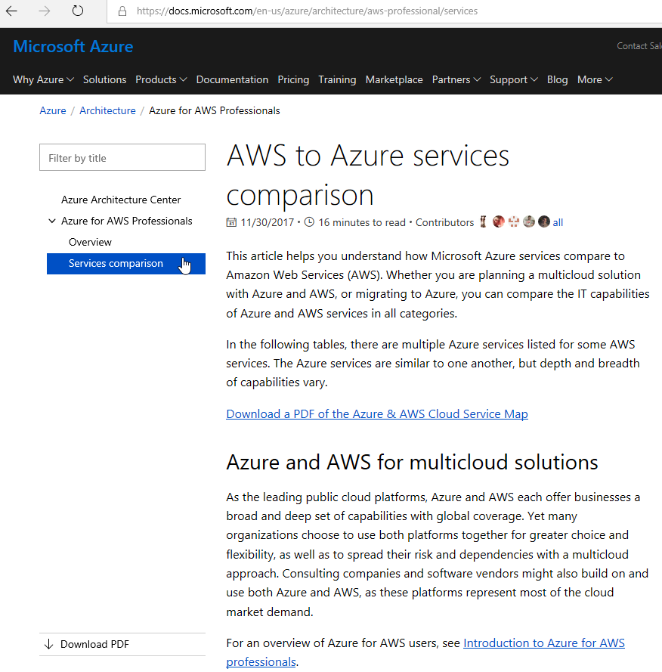
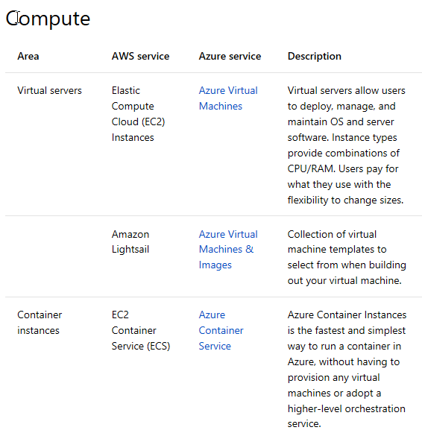
AWS to Azure Services Comparison
https://docs.microsoft.com/en-us/azure/architecture/aws-professional/services

Slide 22
Azure Capacity Planning

Slide 23

Good to know
Azure DOES have limits!! Per Azure Sub and even per Azure Region
Know the Service-specific quota limits - Limits
Some limits are a hard maximum, while others are a soft limit that can be increases upon request.
Involve your Microsoft Architects in planning…. EARLY!!!
You can increase quota!
“But I Thought Azure had Infinite Capacity?”
Limits are Good….Kinda
Limits help keep you cloud spending predictable by not allowing you to spin up the resources that could generate a huge monthly bill without you doing it on purpose. This save you and Microsoft money since they’d likely need to refund lots of cloud spending if all customers were allowed to go unchecked.
Limits help Microsoft throttle the growth of cloud usage; both within individual Azure Regions, as well as Globally across all their datacenter and regions. This allows Microsoft to ensure that individual customers aren’t able to overload any particular Azure Region or data center unexpectedly.
Be an Architect 535 Exam
January 2017

Slide 24

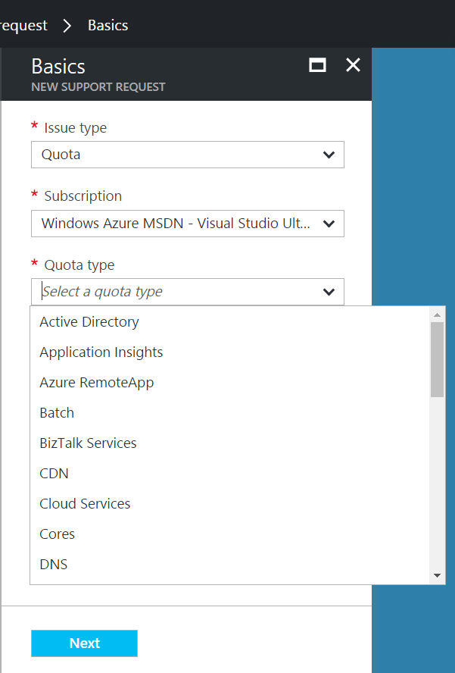
Good to know
Very large quota requests may take more than a day to be processed
Depending on how many cores are requested, a simple credit check initiated by the Support Team may be required
Recommended approach
Step 1: Visit the Azure Portal and click on ‘Help + Support’ and open a new support request.
Step 2: Click ‘Quotas’ under Issue Type and select the type of subscription for which you want to change the quota.
Step 3: Choose the resource type where you want to increase the quota.
Example 1: Increase number of cores
Example 2: Increase Storage
Step 4: Enter your preferred contact method and contact information and create the support case
“How do I increase Azure Quota?”
Support Type: Free Assisted - Billing
January 2017

Slide 25
Architectural capabilities of BC/DR
You need all three
Primary site
Primary site
Secondary site
Original
Backup
DATA
DATA
High availability
Disaster recovery
Backup
When your applications have a catastrophic failure, run a second instance
When your applications have a catastrophic failure, run them in Azure or a secondary datacenter
When your data is corrupted, deleted or lost you can restore it
Notes:
Now let’s make sure we are using the same terminology for the various parts of a business continuity strategy.
HA is
DR is
Backup is
I’m going to focus on Backup and DR.

Slide 26
RPO “Recover Point Objective” & RTO “Recover Time Objective are time intervals, typically expressed in number of hours
RPO is the maximum targeted time that data can be lost (in time)—it is the amount of time between backup, replication, or synchronization. It answers the question, “What is an acceptable amount of data loss?” It is usually much smaller than RTO.
RTO is how long it takes (in time) to restore services after a disaster. It answers the question, “How long will it take to get service back up?”

Slide 27
An asynchronous operation is one that transpires sequentially: first one action, and then another. The operations do not take place simultaneously. This type of processing means that there is a time gap between the first operation and the second. An example would be writing data to primary and secondary storage. First data is written to the primary; data destined for the secondary is queued and must wait until the write operation to the primary is complete.

Slide 28
Synchronous means that operations are carried out at the same time (think of this as parallel processing). With this type of processing, there is no time gap between the first process and the second process. Both operations take place simultaneously.

Slide 29
Architectural capabilities of BC/DR
Recovery Point Objective (RPO) and Recovery Time Objective (RTO)
Drivers of solution cost
Minimal data loss
Reduce downtime
Availability: Storage redundancy & SLAs
Blob storage: (LRS, GRS, RA-GRS), SLAs
Synchronous vs asynchronous (how data is written)
SQL Server Always On Availability Groups (replication for availability)
Network connectivity
Application connectivity post failover
IP management
Load balancers
Notes:
RPO is the amount of data that can be lost (in time)—it is the amount of time between backup, replication, or synchronization. It answers the question, “What is an acceptable amount of data loss?” It is usually much smaller than RTO.
RTO is how long it takes to restore services after a disaster. It answers the question, “How long will it take to get service back up?”

Slide 30
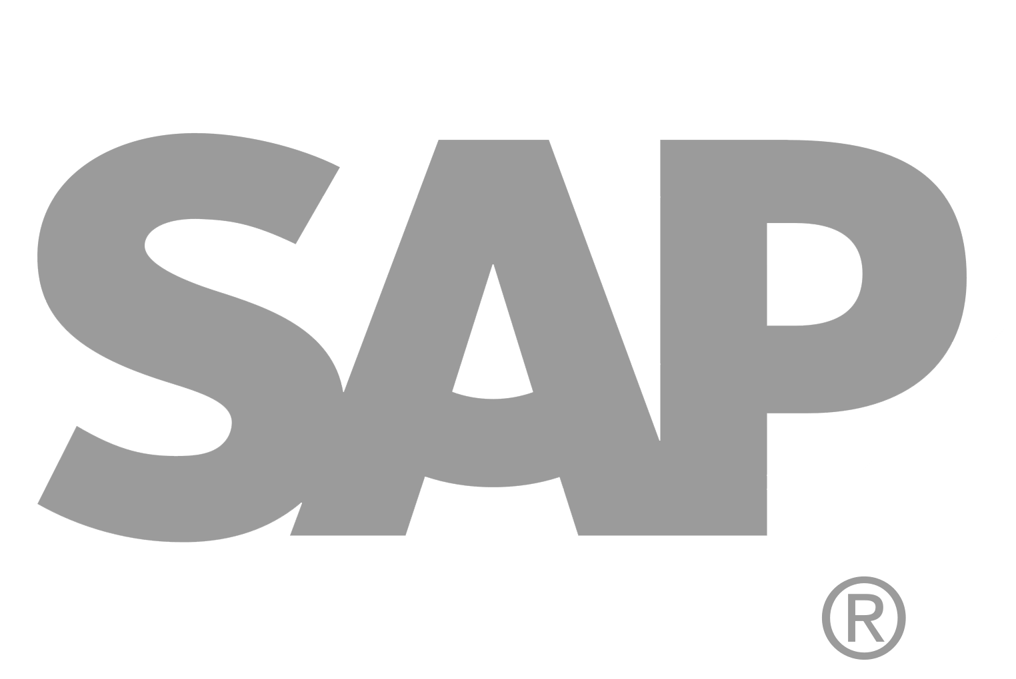
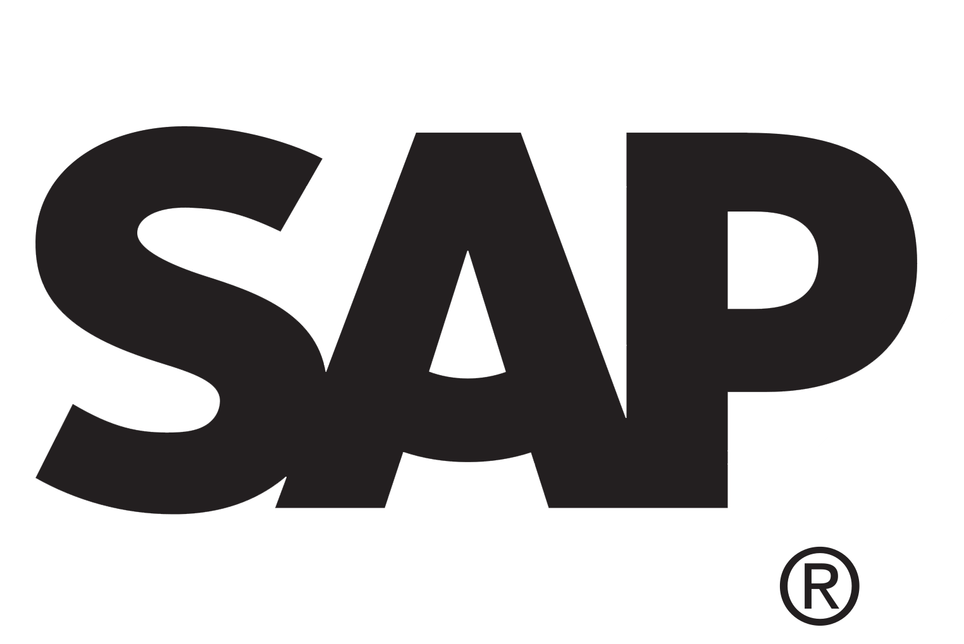
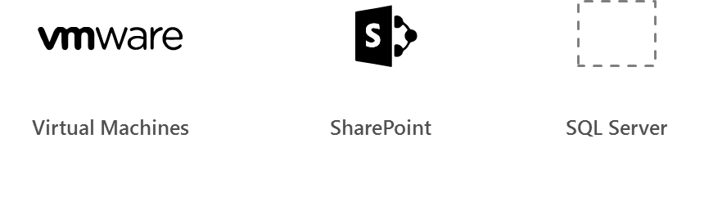
Azure Site Recovery
Azure
Automated, seamless disaster recovery from the cloud to protect applications
Provides application-consistent recovery of critical workloads
Leverage current investments
Orchestrate one-click recovery even for complex multi-tier applications
WHEN NOT
Workload requires synchronous replication, data outside of VHD
Exchange
SAP
Production Environment
SharePoint
App n
Automated
Policy-based
Orchestrated
Encrypted
VPN
ExpressRoute
Downtime
Exchange
SAP
SharePoint
App n
Production Environment
Hyper-V
Bare metal
On-premises/cloud Datacenter

Slide 31
Azure Site Recovery support matrix *
Source | Target | Availability | Supported Guest OS Types
Hyper-V 2012 R2 | Azure | Available | All Guest OS types supported by Azure
Hyper-V 2008 R2 SP1 and 2012 | Azure | Available | Windows* and Linux*
VMware vSphere 5.1, 5.5, 6.0 and Physical Servers | Azure | Available | Windows* and Linux*
Amazon Web Services (Windows AMIs) | Azure | Available | Windows Server 2008 R2 SP1+ (HVM only)
Amazon Web Services (Linux AMIs) | Azure | Available | RHEL 6.7 HVM
Hyper-V 2012 | Hyper-V 2012R2 | Available | All Guest OS types supported by Hyper-V
VMware vSphere 5.1, 5.5, 6.0 | Hyper-V 2012R2 | Available via Microsoft Services Global Delivery | Windows Server 2008 R2 SP1+
* May be asked on the exam what ASR will support for a certain scenario
Source: https://docs.microsoft.com/en-us/azure/site-recovery/
Notes:
Notes:
*Limited to Windows Server 2008 R2 SP1+, Red Hat 6.7, 7.1, 7.2, CentOS 6.5, 6.6, 6.7, 7.0+ Oracle Enterprise Linux 6.4, 6.5, SUSE Linux Enterprise Server 11 SP3
*Documentation: https://docs.microsoft.com/en-us/azure/site-recovery/
Azure VM between Azure Region is in Preview now

Slide 32
Azure BC/DR Capabilities & Use Cases
Hyper-V Replica
Simple, Affordable Second Site
“Extended Replication” + 3rd Party Integration
Hardware Agnostic – either side
Hybrid Cloud
Seamless Integration:
Private Cloud or on-premises to…
Service Provider Cloud
Microsoft Azure
Azure Site Recovery (ASR)
WHEN TO USE: 2nd Site / Use SCCM,SCVMM, Unprotected workloads
WHEN NOT TO USE:
Workload requires synchronous replication, data outside of VHD
Workload needs to recover physical servers, beyond Hyper-V replica’s capabilities

Slide 33
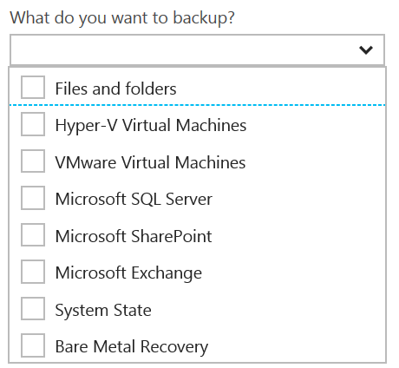
Disaster Recovery Capabilities & Use Cases
Azure Backup
Reliable, Simple, Efficient backup and restore (agent based)
Use for Branch Office or Small Business
Backup and restore files and folders
No Central Management
Azure Backup Server
Disk (D2D), giving high RTOs for tier 1 workloads
Azure (D2D2C) for long term retention
Modern Backup Storage technology (MABS v2)
VMware capabilities
Application Consistency (SQL, Exchange, SharePoint)
No Tape Backup
No Integration with System Center
Requires Azure Subscription
System Center Data Protection Manager (DPM)
Physical, VM, Azure VM
Store Locally to Disks (D2D) and to Tape (D2T)
Store in Azure (D2D2C) for long term retention
Full application consistency across server apps (Exch, SP, SQL…)
Small backup window
Bare Metal Recovery / Recovery to Azure
Full System Center Integration (discovery, reporting, etc)
StorSimple
Proprietary Device | Multiple Tiers
Cloud Integrated Storage (CiS)
Seamless view of ALL Enterprise Storage
Windows and VMWare
Multi-Tiers backup and recovery (Hot/Cold)
Fastest Solution
Long Term Azure storage; scale storage out to Azure
minimize on-premesis disk requirements
Seamless view of ALL Enterprise Storage | Windows and VMWare

Slide 34
Additional Information: SLA for Site Recovery 99.9%
"Failover" is the process of transferring control, either simulated or actual, of a Protected Instance from a primary site to a secondary site.
"On-Premises-to-Azure Failover" is the Failover of a Protected Instance from a non-Azure primary site to an Azure secondary site. Customer may designate a particular Azure datacenter as a secondary site, provided that if Failover to the designated datacenter is not possible, Microsoft may replicate to a different datacenter in the same region.
"On-Premises-to-On-Premises Failover" is the Failover of a Protected Instance from a non-Azure primary site to a non-Azure secondary site.
"Protected Instance" refers to a virtual or physical machine configured for replication by the Site Recovery Service from a primary site to a secondary site. Protected Instances are enumerated in the Protected Items tab in the Recovery Services section of the Management Portal.

Slide 35
Sharding is when you split a database and partition the different parts of the database across multiple drives. A shard is a single horizontal partition of the database.
Notes:
Large table
Just SQL Database table into small
A to D in one database
E to G in another DB
They should be pulled together
You can setup the large database per day basis or per week depending on it.
Existing application can’t be move to sharding. You will have re write the code into the application. Use different API. It is ane xtra work. For scaling point is it amazing. It is only for Relational Database. RDBMS

Slide 36
READ & Practice https://docs.microsoft.com/pdfstore/en-us/Azure.azure-documents/live/backup.pdf
Link from https://docs.microsoft.com/en-us/azure/backup/backup-try-azure-backup-in-10-mins – Download PDF

Slide 37
Azure Backup Key Workloads
Specialized Workloads
File/Folders/Volumes
Virtual Machines
Exchange
SharePoint
SQL Server
Windows Server
Windows
Windows
Linux
Hyper-V
Windows Server
Microsoft Azure
VMware
Notes:
1.
Workload: Files and folders
Source Machine: Windows Server or Windows Client
Azure Backup Solutions:
Azure Backup agent,
System Center DPM (+ the Azure Backup agent),
Azure Backup Server (includes the Azure Backup agent)
2.
Workload: Hyper-V virtual machine (Win & Linux), VMWare Virtual Machine (Win & Linux), Microsoft SQL Server, Microsoft SharePoint, Microsoft Exchange
Source Machine: Windows Server
Azure Backup Solution: System Center DPM (+ the Azure Backup agent); Azure Backup Server (includes the Azure Backup agent)
3.
Workload: Azure IaaS VMs (Windows) and Azure IaaS VMs (Linux)
Source Machine: N/A
Azure Backup Solution: Azure Backup (VM extension)

Slide 38
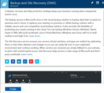
How It Works: Azure Backup Server
2. Register and configure Vault
1. Create Backup and Site Recovery Vault
3. Install Azure Backup Server software
4. Schedule & Back up encrypted data
Azure Backup Windows Server/Client
5. Recover to the same or a different server; On-Premisis or Azure VM
Step-By-Step
https://docs.microsoft.com/en-us/azure/backup/backup-try-azure-backup-in-10-mins
Notes:
Sign Up at the Azure portal
Install Azure Backup Server software
Register and configure
Back up encrypted data
Anytime the data leaves your boundary, it is encrypted. You have the passwords and keys and it’s always restored in Azure.
Recover to the same or a different server

Slide 39
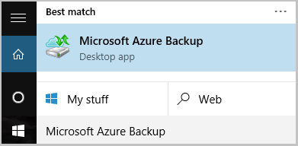
Name of the Backup agent Installer is:
MARSagentinstaller.exe
Backup Agent is
Microsoft Azure Backup
"C:\Program Files\Microsoft Azure Recovery Services Agent\bin\wabadmin.msc"
Maximum rate of backups per day?
Three (3) times per day!
Notes:
Maximum backup is 3 times per day – every 8 hours

Slide 40
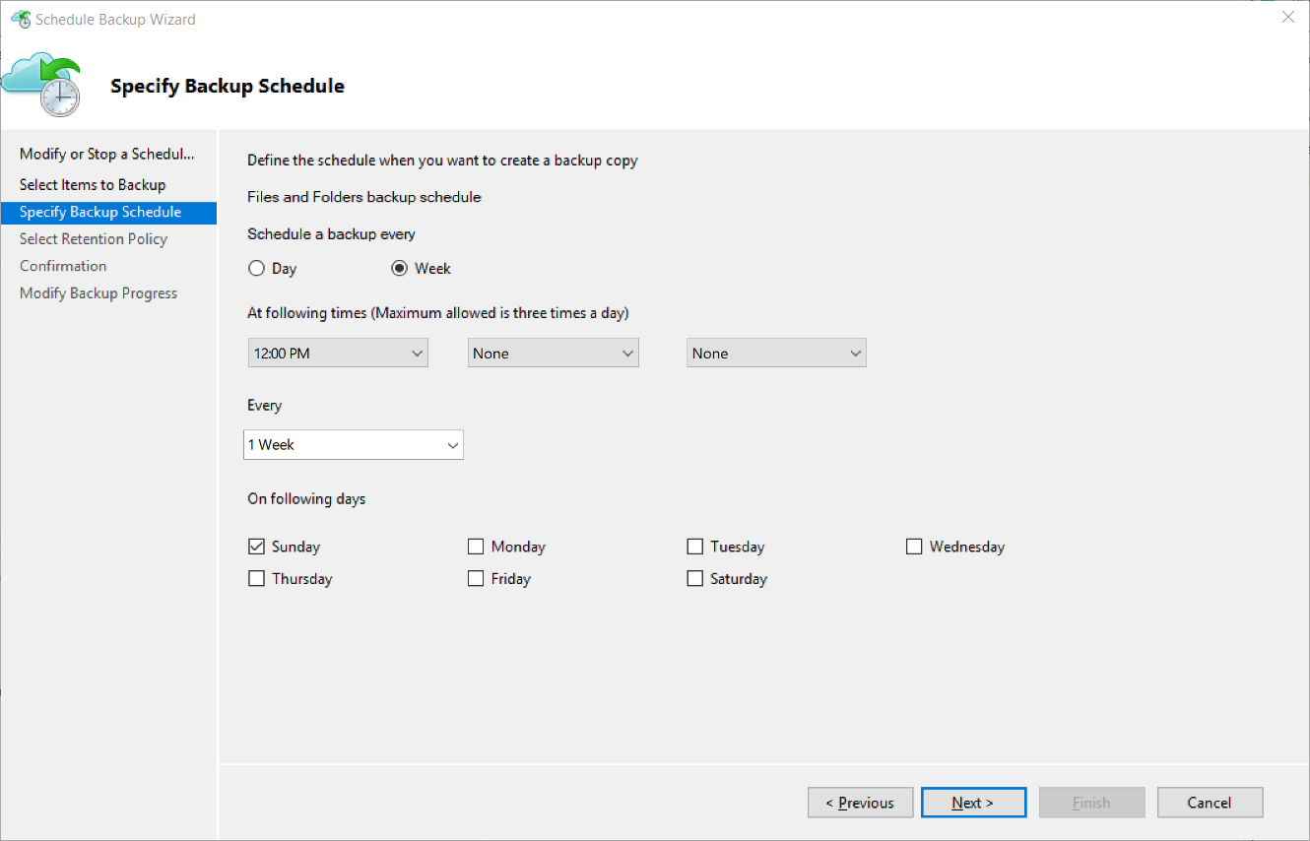
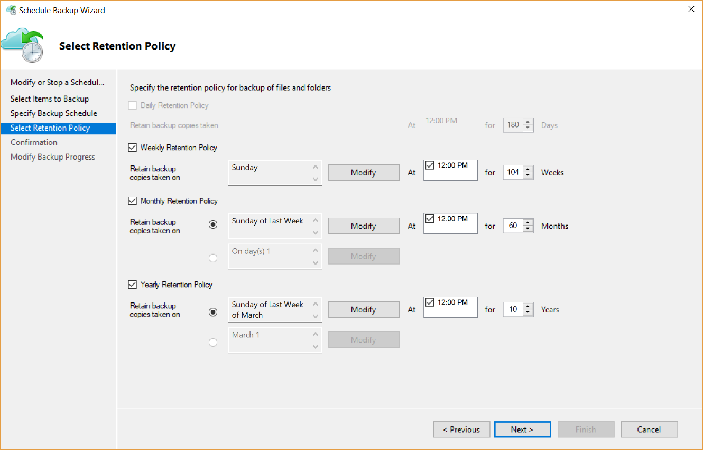
Backup Schedule & Retention Policy
Backup Schedule
Retention Policy

Slide 41
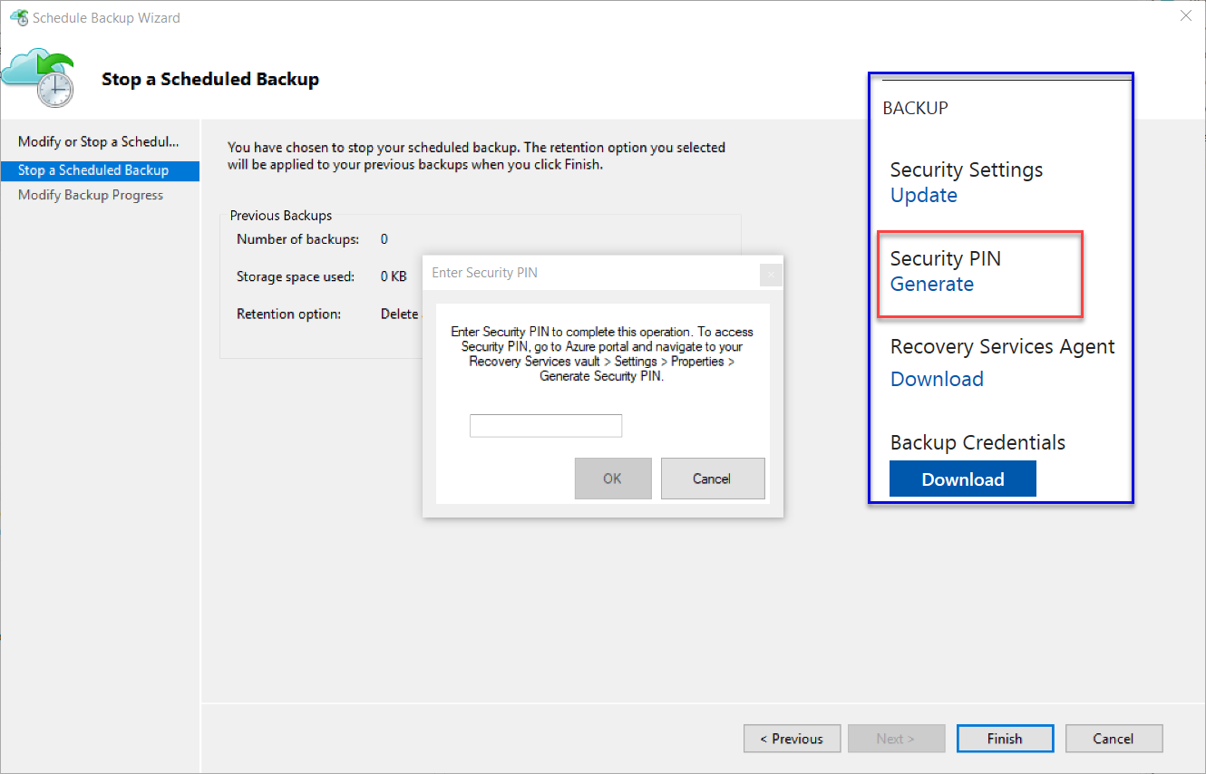
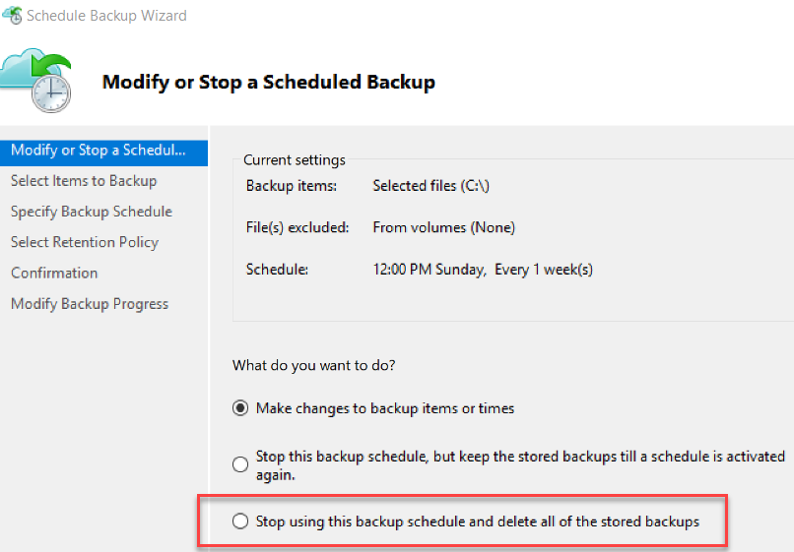
Cancelling Schedule and Removing Backups

Slide 42
Microsoft Azure Backup Server v2
Protect application workloads:
Hyper-V VMs, Microsoft SQL Server, SharePoint Server, Microsoft Exchange and Windows clients
Backup To:
Disk (D2D), giving high RTOs for tier 1 workloads
Azure (D2D2C) for long term retention
Modern Backup Storage technology (MABS v2) store backups:
Using Resilient File System (ReFS) block-cloning technology to store incremental backups,
MABS v2 significantly improves storage usage and performance.
Note: VMware is supported only in testing if Azure Backup Server is deployed on Windows 2016
Microsoft Azure Backup Server (MABS) Deployment:
physical standalone server.
Hyper-V virtual machine
Windows virtual machine in VMWare
Physical standalone server
Hyper-V virtual machine
Windows virtual machine in VMWare
An Azure virtual machine - back up cloud workloads running as Azure virtual machines.
Disks for backup storage pool: 1.5 times size of data to be protected
Docs: https://azure.microsoft.com/en-us/blog/announcing-microsoft-azure-backup-server/
Download: https://www.microsoft.com/en-us/download/details.aspx?id=55269

Slide 43
Documentation / More Info…
Azure Key Vault:
https://docs.microsoft.com/en-us/azure/key-vault/
Azure Backup:
https://docs.microsoft.com/en-us/azure/backup/

Slide 44

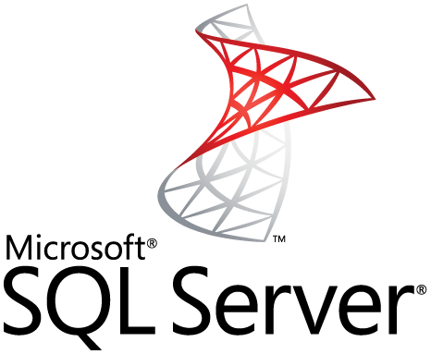

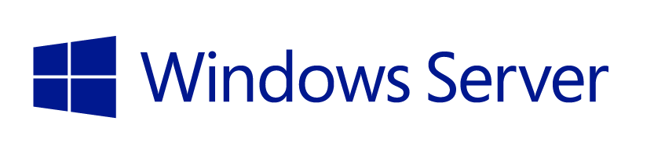
StorSimple Supported workloads
How customers benefit
Infrastructure on-demand workloads
DR
Search / Data mining
Dev / Test
Cloud apps
Capacity driven workloads
Traditional on-premises workloads
File shares
Collaboration
Archives
VM workloads
SharePoint
SQL Server
Notes:
This slide is shows the alignment of different workloads with different capabilities / configurations of StorSimple solution.
For large, unstructured, capacity driven data-sets, use tiered volumes for cloud storage
For performance driven workloads – use local volumes as a local storage.
For on-demand infra requirements like DR, and dev-test, use the StorSimple Cloud Appliance
So what does all these enhancements mean for partners?

Slide 45
EXAM TIP!
StorSimple uses iSCSI protocol to link data storage. This means that the storage that is in Azure is presented as locally attached iSCSI volumes.

Slide 46
Azure Backup Key Workloads
Specialized Workloads
File/Folders/Volumes
Virtual Machines
Exchange
SharePoint
SQL Server
Windows Server
Windows
Windows
Linux
Hyper-V
Windows Server
Microsoft Azure
VMware
Notes:
1.
Workload: Files and folders
Source Machine: Windows Server or Windows Client
Azure Backup Solutions:
Azure Backup agent,
System Center DPM (+ the Azure Backup agent),
Azure Backup Server (includes the Azure Backup agent)
2.
Workload: Hyper-V virtual machine (Win & Linux), VMWare Virtual Machine (Win & Linux), Microsoft SQL Server, Microsoft SharePoint, Microsoft Exchange
Source Machine: Windows Server
Azure Backup Solution: System Center DPM (+ the Azure Backup agent); Azure Backup Server (includes the Azure Backup agent)
3.
Workload: Azure IaaS VMs (Windows) and Azure IaaS VMs (Linux)
Source Machine: N/A
Azure Backup Solution: Azure Backup (VM extension)

Slide 47
How It Works: Azure Backup Server
2. Register and configure Vault
1. Create Backup and Site Recovery Vault
3. Install Azure Backup Server software
4. Schedule & Back up encrypted data
Azure Backup Windows Server/Client
5. Recover to the same or a different server; On-Premisis or Azure VM
Step-By-Step
https://docs.microsoft.com/en-us/azure/backup/backup-try-azure-backup-in-10-mins
Notes:
Sign Up at the Azure portal
Install Azure Backup Server software
Register and configure
Back up encrypted data
Anytime the data leaves your boundary, it is encrypted. You have the passwords and keys and it’s always restored in Azure.
Recover to the same or a different server

Slide 48
Name of the Backup agent Installer is:
MARSagentinstaller.exe
Backup Agent is
Microsoft Azure Backup
"C:\Program Files\Microsoft Azure Recovery Services Agent\bin\wabadmin.msc"
Maximum rate of backups per day?
Three (3) times per day!
Notes:
Maximum backup is 3 times per day – every 8 hours

Slide 49
Backup Schedule & Retention Policy
Backup Schedule
Retention Policy

Slide 50
Cancelling Schedule and Removing Backups

Slide 51
Azure Site Recovery
Azure
Automated, seamless disaster recovery from the cloud to protect applications
Provides application-consistent recovery of critical workloads
Leverage current investments
Orchestrate one-click recovery even for complex multi-tier applications
WHEN NOT
Workload requires synchronous replication, data outside of VHD
Exchange
SAP
Production Environment
SharePoint
App n
Automated
Policy-based
Orchestrated
Encrypted
VPN
ExpressRoute
Downtime
Exchange
SAP
SharePoint
App n
Production Environment
Hyper-V
Bare metal
On-premises/cloud Datacenter

Slide 52
Azure Site Recovery support matrix *
Source | Target | Availability | Supported Guest OS Types
Hyper-V 2012 R2 | Azure | Available | All Guest OS types supported by Azure
Hyper-V 2008 R2 SP1 and 2012 | Azure | Available | Windows* and Linux*
VMware vSphere 5.1, 5.5, 6.0 and Physical Servers | Azure | Available | Windows* and Linux*
Amazon Web Services (Windows AMIs) | Azure | Available | Windows Server 2008 R2 SP1+ (HVM only)
Amazon Web Services (Linux AMIs) | Azure | Available | RHEL 6.7 HVM
Hyper-V 2012 | Hyper-V 2012R2 | Available | All Guest OS types supported by Hyper-V
VMware vSphere 5.1, 5.5, 6.0 | Hyper-V 2012R2 | Available via Microsoft Services Global Delivery | Windows Server 2008 R2 SP1+
* May be asked on the exam what ASR will support for a certain scenario
Source: https://docs.microsoft.com/en-us/azure/site-recovery/
Notes:
Notes:
*Limited to Windows Server 2008 R2 SP1+, Red Hat 6.7, 7.1, 7.2, CentOS 6.5, 6.6, 6.7, 7.0+ Oracle Enterprise Linux 6.4, 6.5, SUSE Linux Enterprise Server 11 SP3
*Documentation: https://docs.microsoft.com/en-us/azure/site-recovery/
Azure VM between Azure Region is in Preview now

Slide 53
Azure BC/DR Capabilities & Use Cases
Hyper-V Replica
Simple, Affordable Second Site
“Extended Replication” + 3rd Party Integration
Hardware Agnostic – either side
Hybrid Cloud
Seamless Integration:
Private Cloud or on-premises to…
Service Provider Cloud
Microsoft Azure
Azure Site Recovery (ASR)
WHEN TO USE: 2nd Site / Use SCCM,SCVMM, Unprotected workloads
WHEN NOT TO USE:
Workload requires synchronous replication, data outside of VHD
Workload needs to recover physical servers, beyond Hyper-V replica’s capabilities

Slide 54
Disaster Recovery Capabilities & Use Cases
Azure Backup
Reliable, Simple, Efficient backup and restore (agent based)
Use for Branch Office or Small Business
Backup and restore files and folders
No Central Management
Azure Backup Server
Disk (D2D), giving high RTOs for tier 1 workloads
Azure (D2D2C) for long term retention
Modern Backup Storage technology (MABS v2)
VMware capabilities
Application Consistency (SQL, Exchange, SharePoint)
No Tape Backup
No Integration with System Center
Requires Azure Subscription
System Center Data Protection Manager (DPM)
Physical, VM, Azure VM
Store Locally to Disks (D2D) and to Tape (D2T)
Store in Azure (D2D2C) for long term retention
Full application consistency across server apps (Exch, SP, SQL…)
Small backup window
Bare Metal Recovery / Recovery to Azure
Full System Center Integration (discovery, reporting, etc)
StorSimple
Proprietary Device | Multiple Tiers
Cloud Integrated Storage (CiS)
Seamless view of ALL Enterprise Storage
Windows and VMWare
Multi-Tiers backup and recovery (Hot/Cold)
Fastest Solution
Long Term Azure storage; scale storage out to Azure
minimize on-premesis disk requirements
Seamless view of ALL Enterprise Storage | Windows and VMWare

Slide 55
Additional Information: SLA for Site Recovery 99.9%
"Failover" is the process of transferring control, either simulated or actual, of a Protected Instance from a primary site to a secondary site.
"On-Premises-to-Azure Failover" is the Failover of a Protected Instance from a non-Azure primary site to an Azure secondary site. Customer may designate a particular Azure datacenter as a secondary site, provided that if Failover to the designated datacenter is not possible, Microsoft may replicate to a different datacenter in the same region.
"On-Premises-to-On-Premises Failover" is the Failover of a Protected Instance from a non-Azure primary site to a non-Azure secondary site.
"Protected Instance" refers to a virtual or physical machine configured for replication by the Site Recovery Service from a primary site to a secondary site. Protected Instances are enumerated in the Protected Items tab in the Recovery Services section of the Management Portal.

Slide 56
READ & Practice https://docs.microsoft.com/pdfstore/en-us/Azure.azure-documents/live/backup.pdf
Link from https://docs.microsoft.com/en-us/azure/backup/backup-try-azure-backup-in-10-mins – Download PDF

Slide 57
Post Event Wrap/Up

Slide 58
Time For Feedback!

Slide 59
Show of Hands
Who feels like the knowledge you obtained in this class will help your company?

Slide 60
Show of Hands
Who feels like the knowledge you obtained in this class will help your career?

Slide 61
Do you want more free training for you, your friends and peers?
Feedback is very, very important to Microsoft. It is the mechanism we use to get additional funding to have more workshops.
Please help us help you & your peers, now and in the future. Give us the evidence that this is a worthwhile investment.
It only takes a couple minutes to fill out the survey at the end of the class. Even if you miss some of the class, it is very important that we get your feedback!
THANK YOU! From our entire training team!!!

Slide 62
Live Feedback: In your own words: What did you think of …
Please provide:
Contact First+Last Initial:
Company [optional]:
Event
Content
Speakers
Topics
Event Flow
Azure Capabilities
Training Leading to Cert
Workshop Model/Flow
Specific Azure Service
Value to You personally
Value to your company
Other

Slide 63
Feedback: Making the Most of the event Your Projects
What types of project(s) do you have or hope to drive where Azure may provide a solution?
Open Discussion
Project:
Contact First+Last Initial:
Company [optional]:
Can you benefit from help from Microsoft:

Slide 64
What can we do better?
Please email dstolts@microsoft.com

Slide 65
Evaluation Form Super Important. Please invest another 2 minutes now to fill out the event survey.
URL: https://tinyurl.com/514MA18

